Slide 1
LEAD SCORING CASE STUDY
Created by –
Rahul Sarkar
Sharani Kalai

Slide 2
PROBLEM STATEMENT
An education company named X Education sells online courses to industry professionals. On any given day, many professionals who are interested in the courses land on their website and browse for courses.
The company markets its courses on several websites and search engines like Google. Once these people land on the website, they might browse the courses or fill up a form for the course or watch some videos. When these people fill up a form providing their email address or phone number, they are classified to be a lead. Once these leads are acquired, employees from the sales team start making calls, writing emails, etc. Through this process, some of the leads get converted while most do not. The typical lead conversion rate at X education is around 30%.
To make this process more efficient, the company wishes to identify the most potential leads, also known as ‘Hot Leads’. If they successfully identify this set of leads, the lead conversion rate should go up as the sales team will now be focusing more on communicating with the potential leads rather than making calls to everyone.

Slide 3
ANALYSIS APPROACH
We have built a Logistic Regression Model using the data provided, which will be capable of predicting the Lead Score of each Lead where higher the Score out of 100, higher the probability of getting the lead converted.
To do this, we have tried to understand the data provided in the dataset, through different analysis and visualizations.
This Analysis and Visualizations helped us in finding the most important features impacting the lead conversion in the prediction model.
We have used Recursive Feature Elimination(RFE) Technique along with Statsmodel Regression Statistics and Variance Inflation Factor(VIF) to get the best features for the model.
After the model is built we have evaluated different Performance Metrics like Accuracy, Sensitivity & Specificity to check the performance of the model.
We think the predictions from the model would be very helpful for the CEO to assess the action items for the Sales team and increase the Lead Conversion rate of the company.

Slide 4
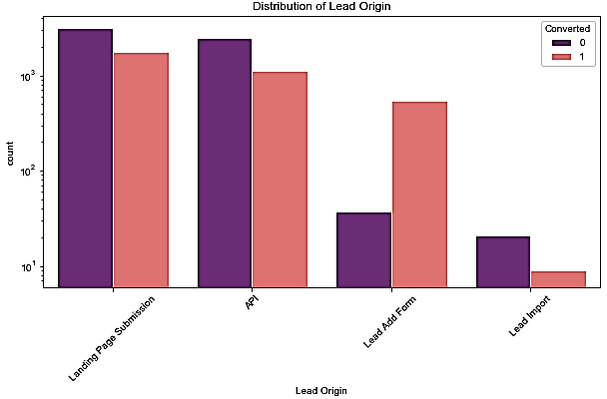
DISTRIBUTION OF LEAD ORIGIN
Landing Page Submission & API has the highest number of leads and have the most number of conversions.
Lead Import has the lowest number of leads and has the least number of conversions.
Lead Add Form is the only category which has a very high conversion rate.

Slide 5
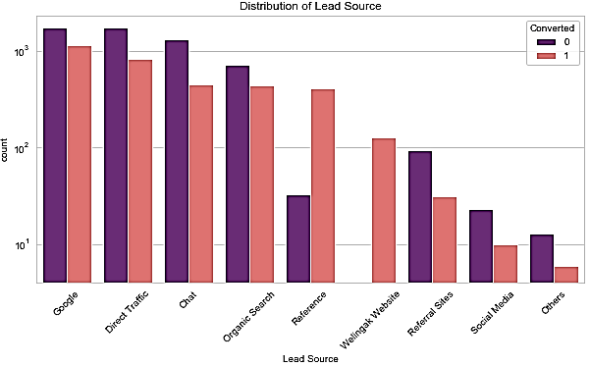
DISTRIBUTION OF LEAD SOURCE
Google and Direct Traffic has the highest number of leads and Google has most number of lead conversions.
Others category have the lowest number of leads and least number of conversions.
Reference & Welingak Website are the only categories having very high lead conversion rate.

Slide 6
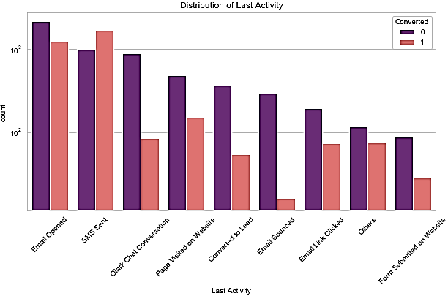
DISTRIBUTION OF LAST ACTIVITY
Email Opened has the most number of leads.
SMS Sent has the highest number of conversions and the only category having very high conversion rate.
Olark Chat Conversation & Email Bounced has the least conversion rate instead of having high number of leads.

Slide 7
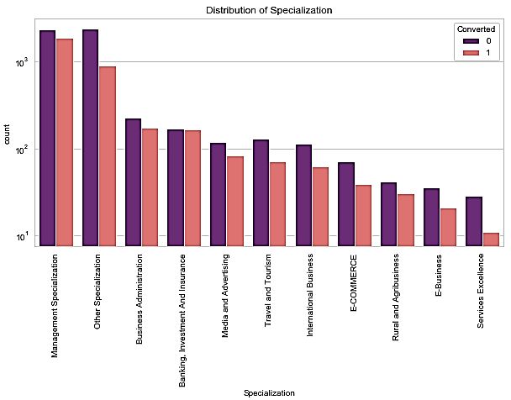
DISTRIBUTION OF SPECIALIZATION
Management Specialization has the highest number of leads and has the highest lead conversion rate.
Services Excellence has the least number of leads and least lead conversion rate.

Slide 8
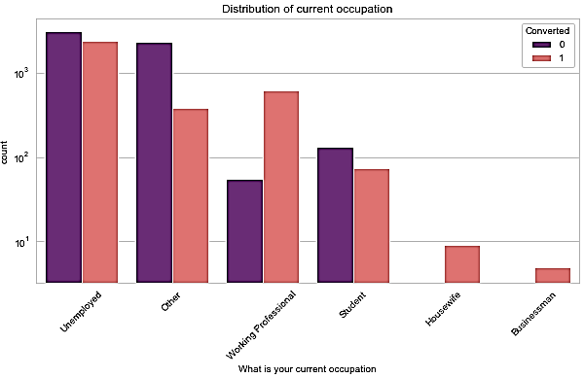
DISTRIBUTION OF CURRENT OCCUPATION
Unemployed people have the highest number of leads.
Housewife & Businessman have the least number of leads and but also they have the 100% conversion rate.
Working Professional have a high number of leads and has high lead conversion rate.

Slide 9
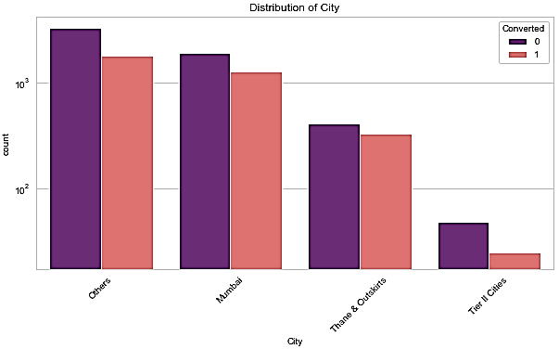
DISTRIBUTION OF CITY
Mumbai and Other cities have a high number of leads and have a good conversion rate.
Tier II Cities have the lowest number of leads and least conversion rate among all.

Slide 10
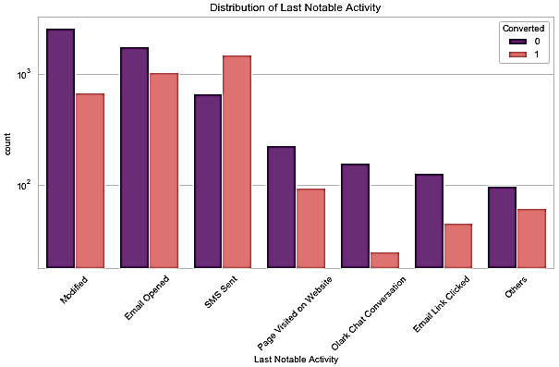
DISTRIBUTION OF LAST NOTABLE ACTIVITY
Last Notable Activity of Modified has the highest number of leads but the conversion rate is not the highest.
Last Notable Activity of SMS Sent has the highest lead Conversion rate having a good number of leads.
Last Notable Activity of Olark Chat Conversation & Email Link Clicked has the least conversion rate.

Slide 11
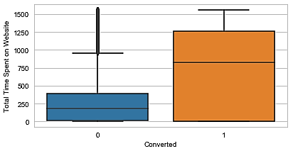
ANALYSIS OF TOTAL TIME SPENT ON WEBSITE
Total Time Spent on Website column has a much higher median value for Converted leads. This means that more the time spent on Website, more the chances of Converting the lead and this column would be very helpful in determining if the lead can be converted.

Slide 12
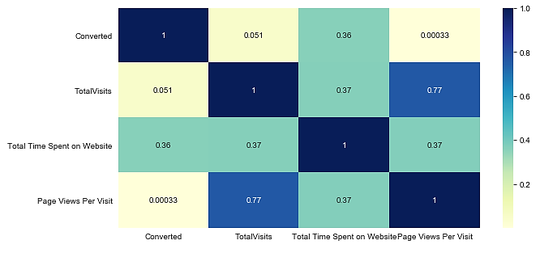
HEATMAP OF NUMERICAL FEATURES
From the Correlation plot/Heat map, we can observe that
The feature Total Time Spent on Website has the highest collinearity with Converted feature, hence better feature impacting the Conversion of lead.
The features Page Views Per Visit & TotalVisits have a high correlation of 0.77 and when building the model, this would affect the model due to multicollinearity.

Slide 13
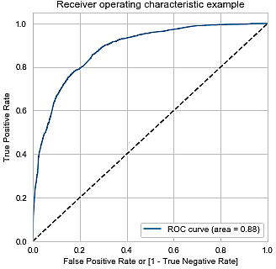
ROC Curve
An ROC curve (receiver operating characteristic curve) is a graph showing the performance of a classification model at all classification thresholds. It shows the tradeoff between sensitivity and specificity. The closer the curve follows the left-hand border and then the top border of the ROC space, the more accurate the test.
The Area under ROC Curve is coming out to be 0.88. It looks like a good value and we can proceed with the model.

Slide 14
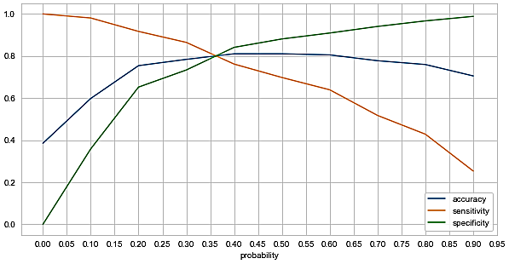
Optimal Cut-off Probability
Optimal cutoff probability is the probability where we get balanced accuracy, sensitivity & specificity.
From the above curve, we can observe that 0.36 is the optimum point to take as a cut-off probability.
So, we can conclude that any lead having lead score above 36 is most likely to be converted.

Slide 15
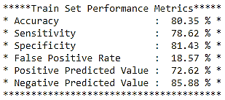
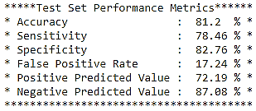
Model Performance Metrics
Above are the different Performance Metrics of the Logistic Regression Model for the Training dataset on which the Model has been built and the Test dataset on which the predictions have been performed after building the model.
Both the Metrics are almost similar indicating a good model for prediction.

Slide 16
CONCLUSION
The Lead Score has been added by the model on the dataset. Thus model can be used by the CEO to provide the Sales team with the Lead Score, which will save time for the team and will allow the team to approach the leads most likely to be converted on priority.
If at any point in time, the company wants to focus on only the leads who has the most chances of converting, then we should start from the leads having highest Lead Score. Score of 36 is the cut-off score according to the model, meaning below this score, leads are very less likely to be converted.
If the company wants to increase the Conversion rate, then it should focus on
Lead having Current Occupation as ‘Working Professional’
Lead Originated from ‘Lead Add Form’
Lead having Current Occupation ‘Student’

